Slide 1

Capstone Project: Netflix Data 2017
BY Analyst: Vaibhav Talekar

Slide 2
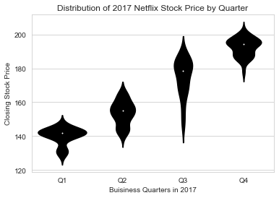
Distribution of 2017 Netflix Stock Price by Quarter
As we can see the closing stock price increases significantly every quarter around 20 dollars.
Price range : 120 – 220
Min in Q1 : 125
Max in Q3 : 210
Having most Fluctuation in Q3.

Slide 3
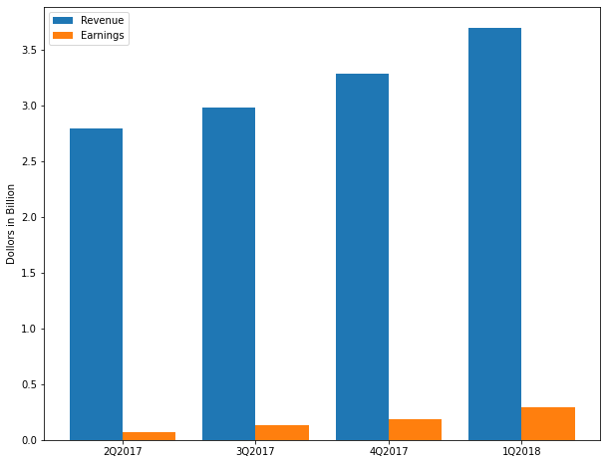
Earnings and Revenue reported by Netflix
Both Revenue and Earning shows upward tread per quarter.
The Percentage of earning :
2Q2017 = 2.35%
3Q2017 = 4.34%
4Q2017 = 5.63%
1Q2018 = 7.84%

Slide 4
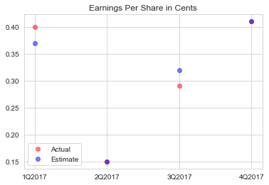
Earnings Per Share in cents.
According to estimate Yahoo projected for the Quarter.
Estimate in Q2 and Q4 were accurate while Q1 and Q3 differ by 0.3 - 0. 5 cents.

Slide 5
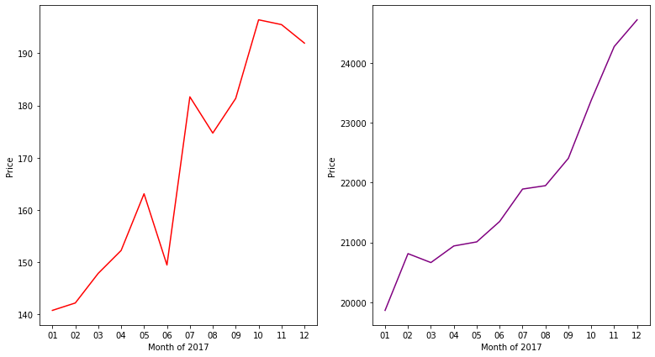
Comparing Netflix stock to the Dow Jones Industrial Average in 2017
Netflix Price jumps in the month of May from 150 to 160 and then sank again from 160 to 145 in month of July.
Both Netflix and Dow Jones average shows upward trend in year 2017.
Netflix Trend is a lot more volatile than Dow Jones as it is not smooth.
Netflix Avg Price 2017 : 168.07
Dow Jones
Avg Price :
21937.62

Slide 6
Conclusion
Hope my analysis , communicate a data set clearly and effectively by using graphics. The best visualizations make it easy to comprehend data at a glance.
Thank You

